Slide 1
Top quark and Higgs boson physics at the LHC (a personal selection)
Rebeca Gonzalez Suarez

Slide 2
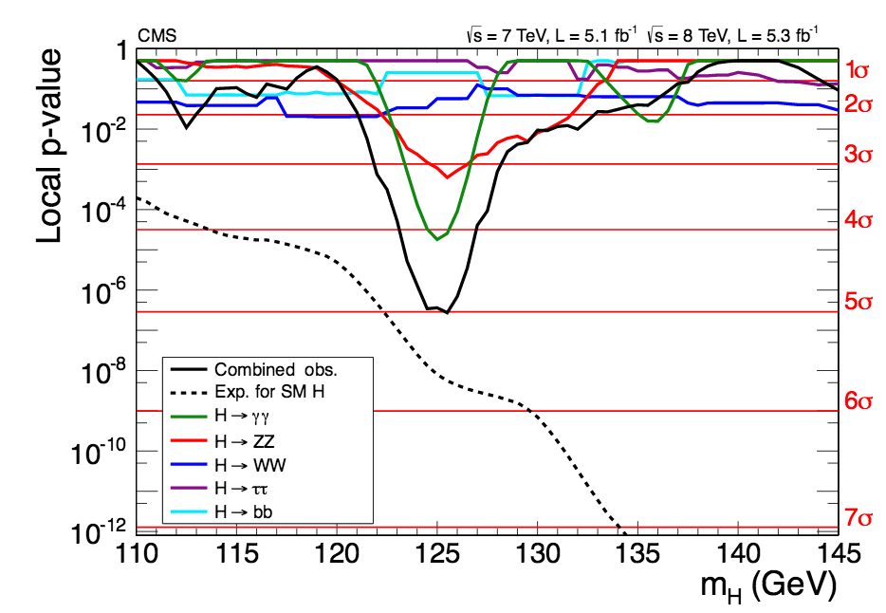
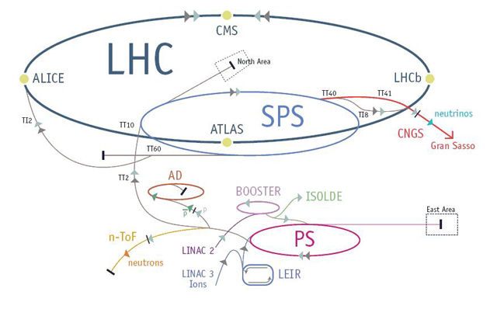
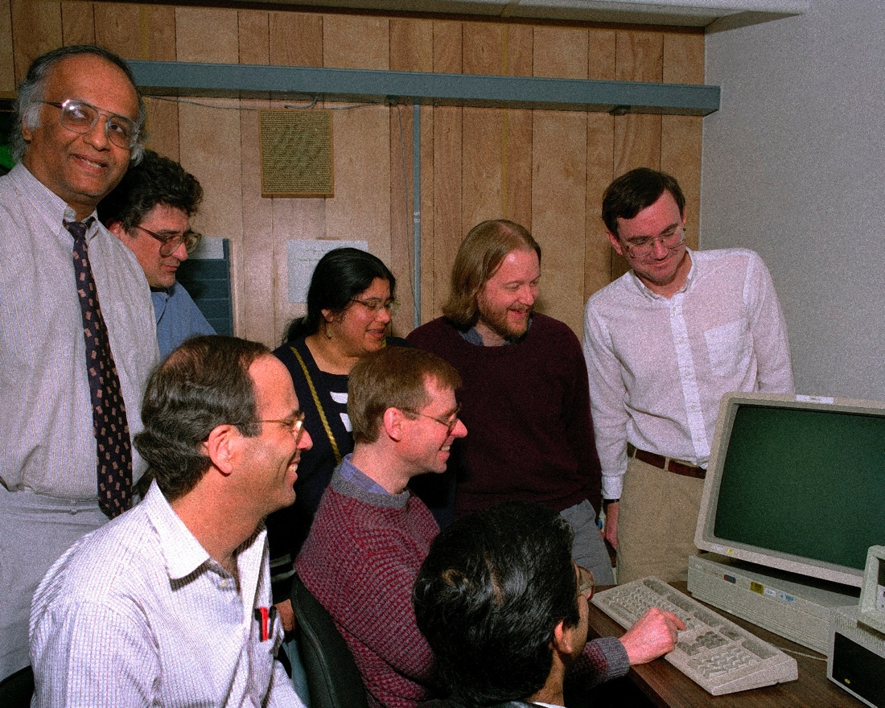
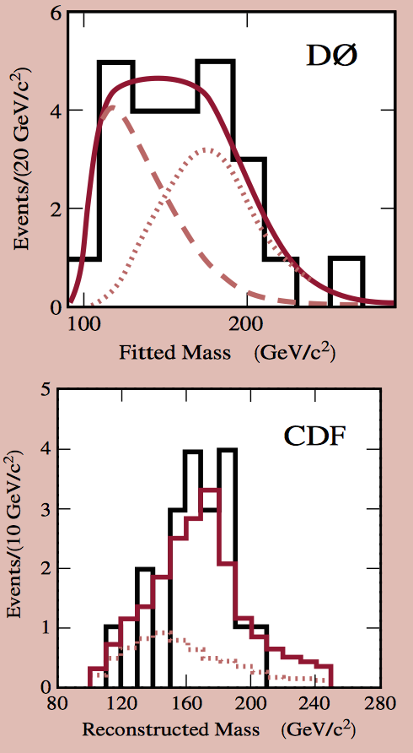

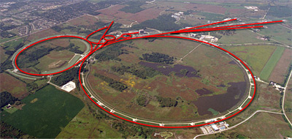
Two discoveries separated by 17 years
Top quark discovery
Higgs boson discovery
February 24, 1995 – Tevatron
CDF → arXiv:9503002
D0 → arXiv:9503003
July 4, 2012 – LHC
ATLAS → arXiv:1207.7214
CMS → arXiv:1207.7235

Slide 3
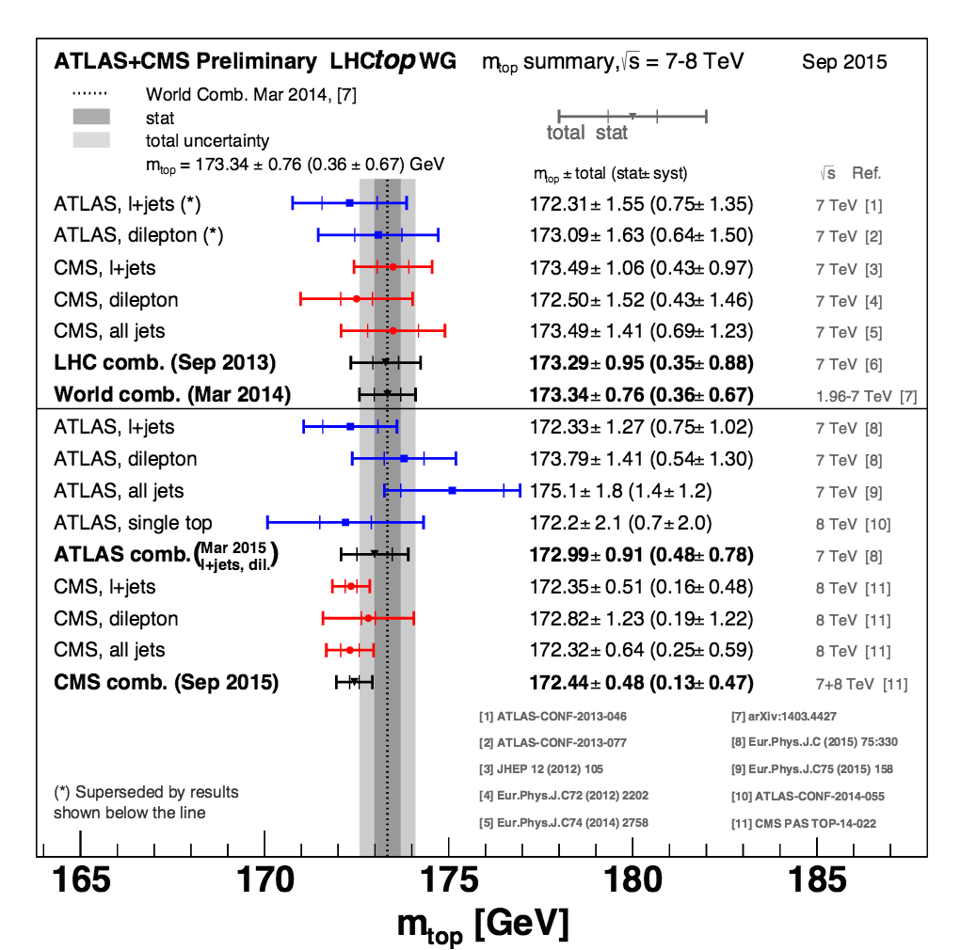
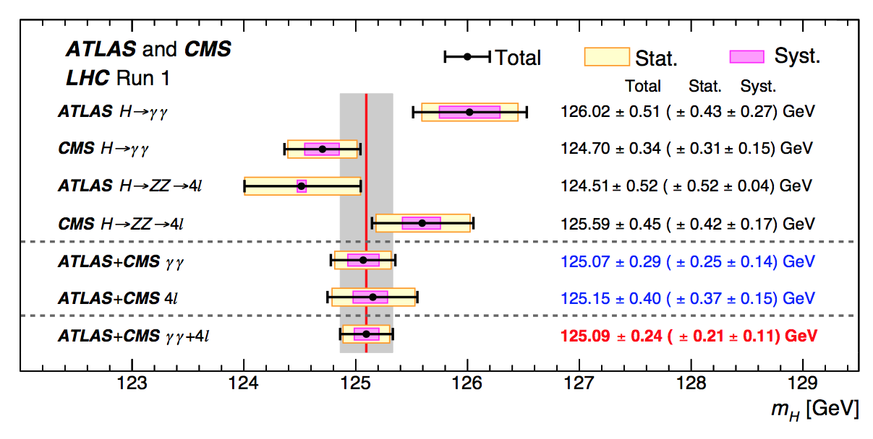
Two particles
Top quark
Higgs boson
Heaviest elementary particle known
As heavy as an atom of gold
Only quark that decays before hadronizing
First scalar particle observed in nature
Confirms the Higgs mechanism of mass generation via spontaneous EW symmetry breaking

Slide 4
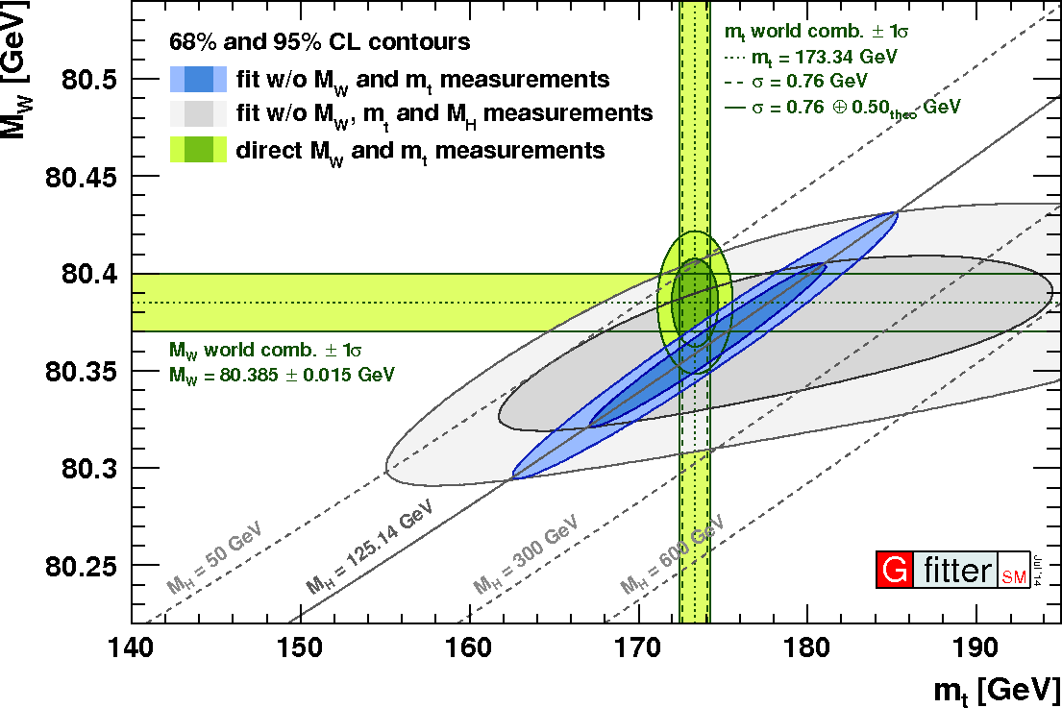
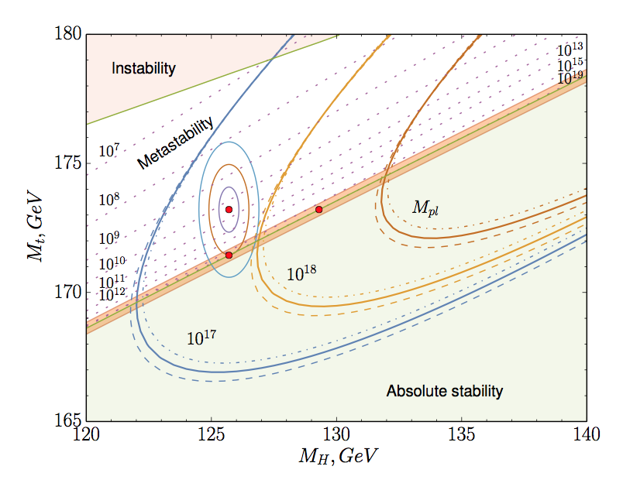
that are deeply related
The top-Higgs coupling is very strong in the Standard Model (SM) ~1
The Higgs mass is extremely sensitive to the top mass → the masses of the top quark and the W boson directly constrain the mass of the SM Higgs
gfitter
arXiv:1507.08833
The Higgs boson and the top quark also allow conclusions regarding the fate of the Universe via the analysis of the vacuum stability → related to the top and Higgs masses

Slide 5
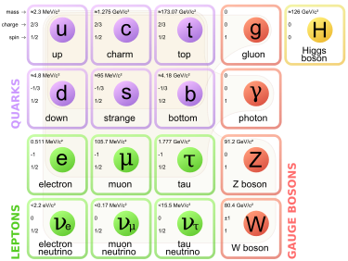
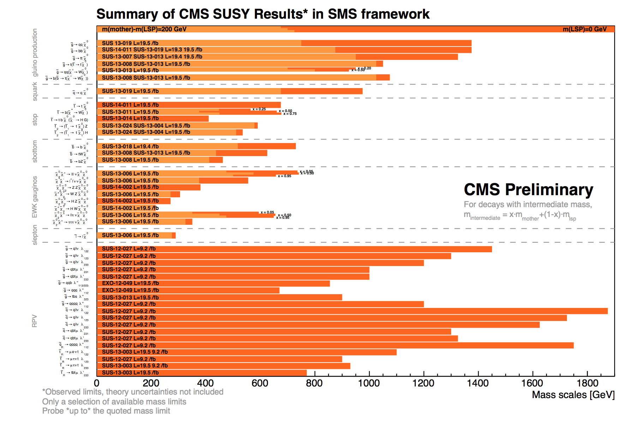
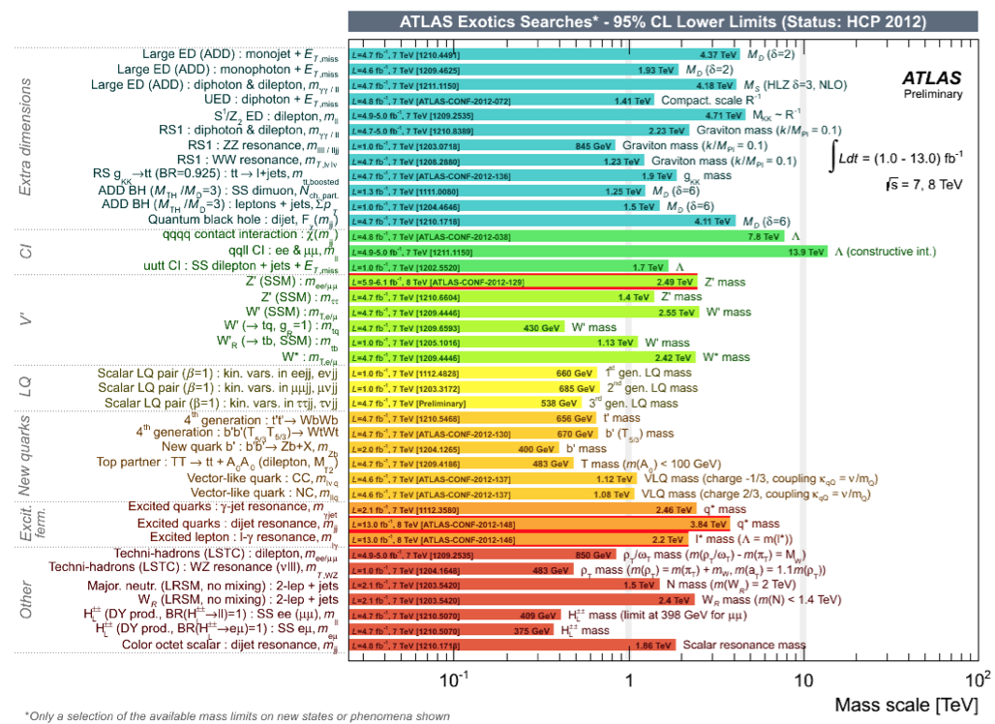
The SM picture
The top discovery completed the quark family, while the Higgs boson is consistent with the Standard Model so far
However: no strong hints of physics beyond the SM (BSM) observed up to now
New physics are needed: there are experimental facts that the SM cannot explain (yet) and call for an extension

Slide 6
In fact, there are many open questions
Is m_{H} natural or fine-tuned? if natural → need new physics/symmetry
Is the Higgs elementary or composite?
Is there just one Higgs or many?
Why only three quark families?
Why do the neutrinos have masses?
The matter/anti-matter imbalance in the Universe
What is the nature of the dark matter and dark energy?
Why is the scale of particle physics so much smaller than the Planck Scale and the observable Universe is so much bigger than the Planck Scale?
How is gravity connected with the other forces?
Do forces unify at high energy?
… to name a few

Slide 7
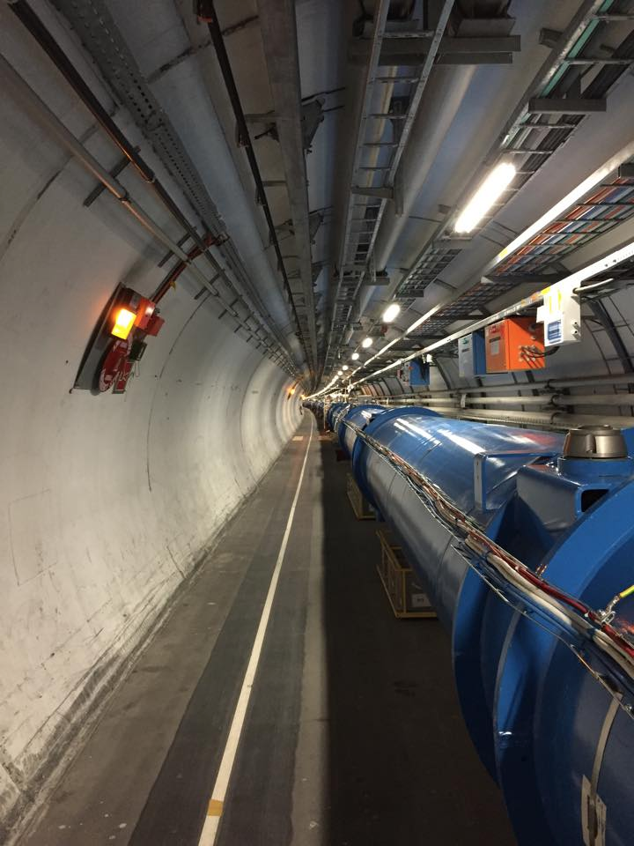
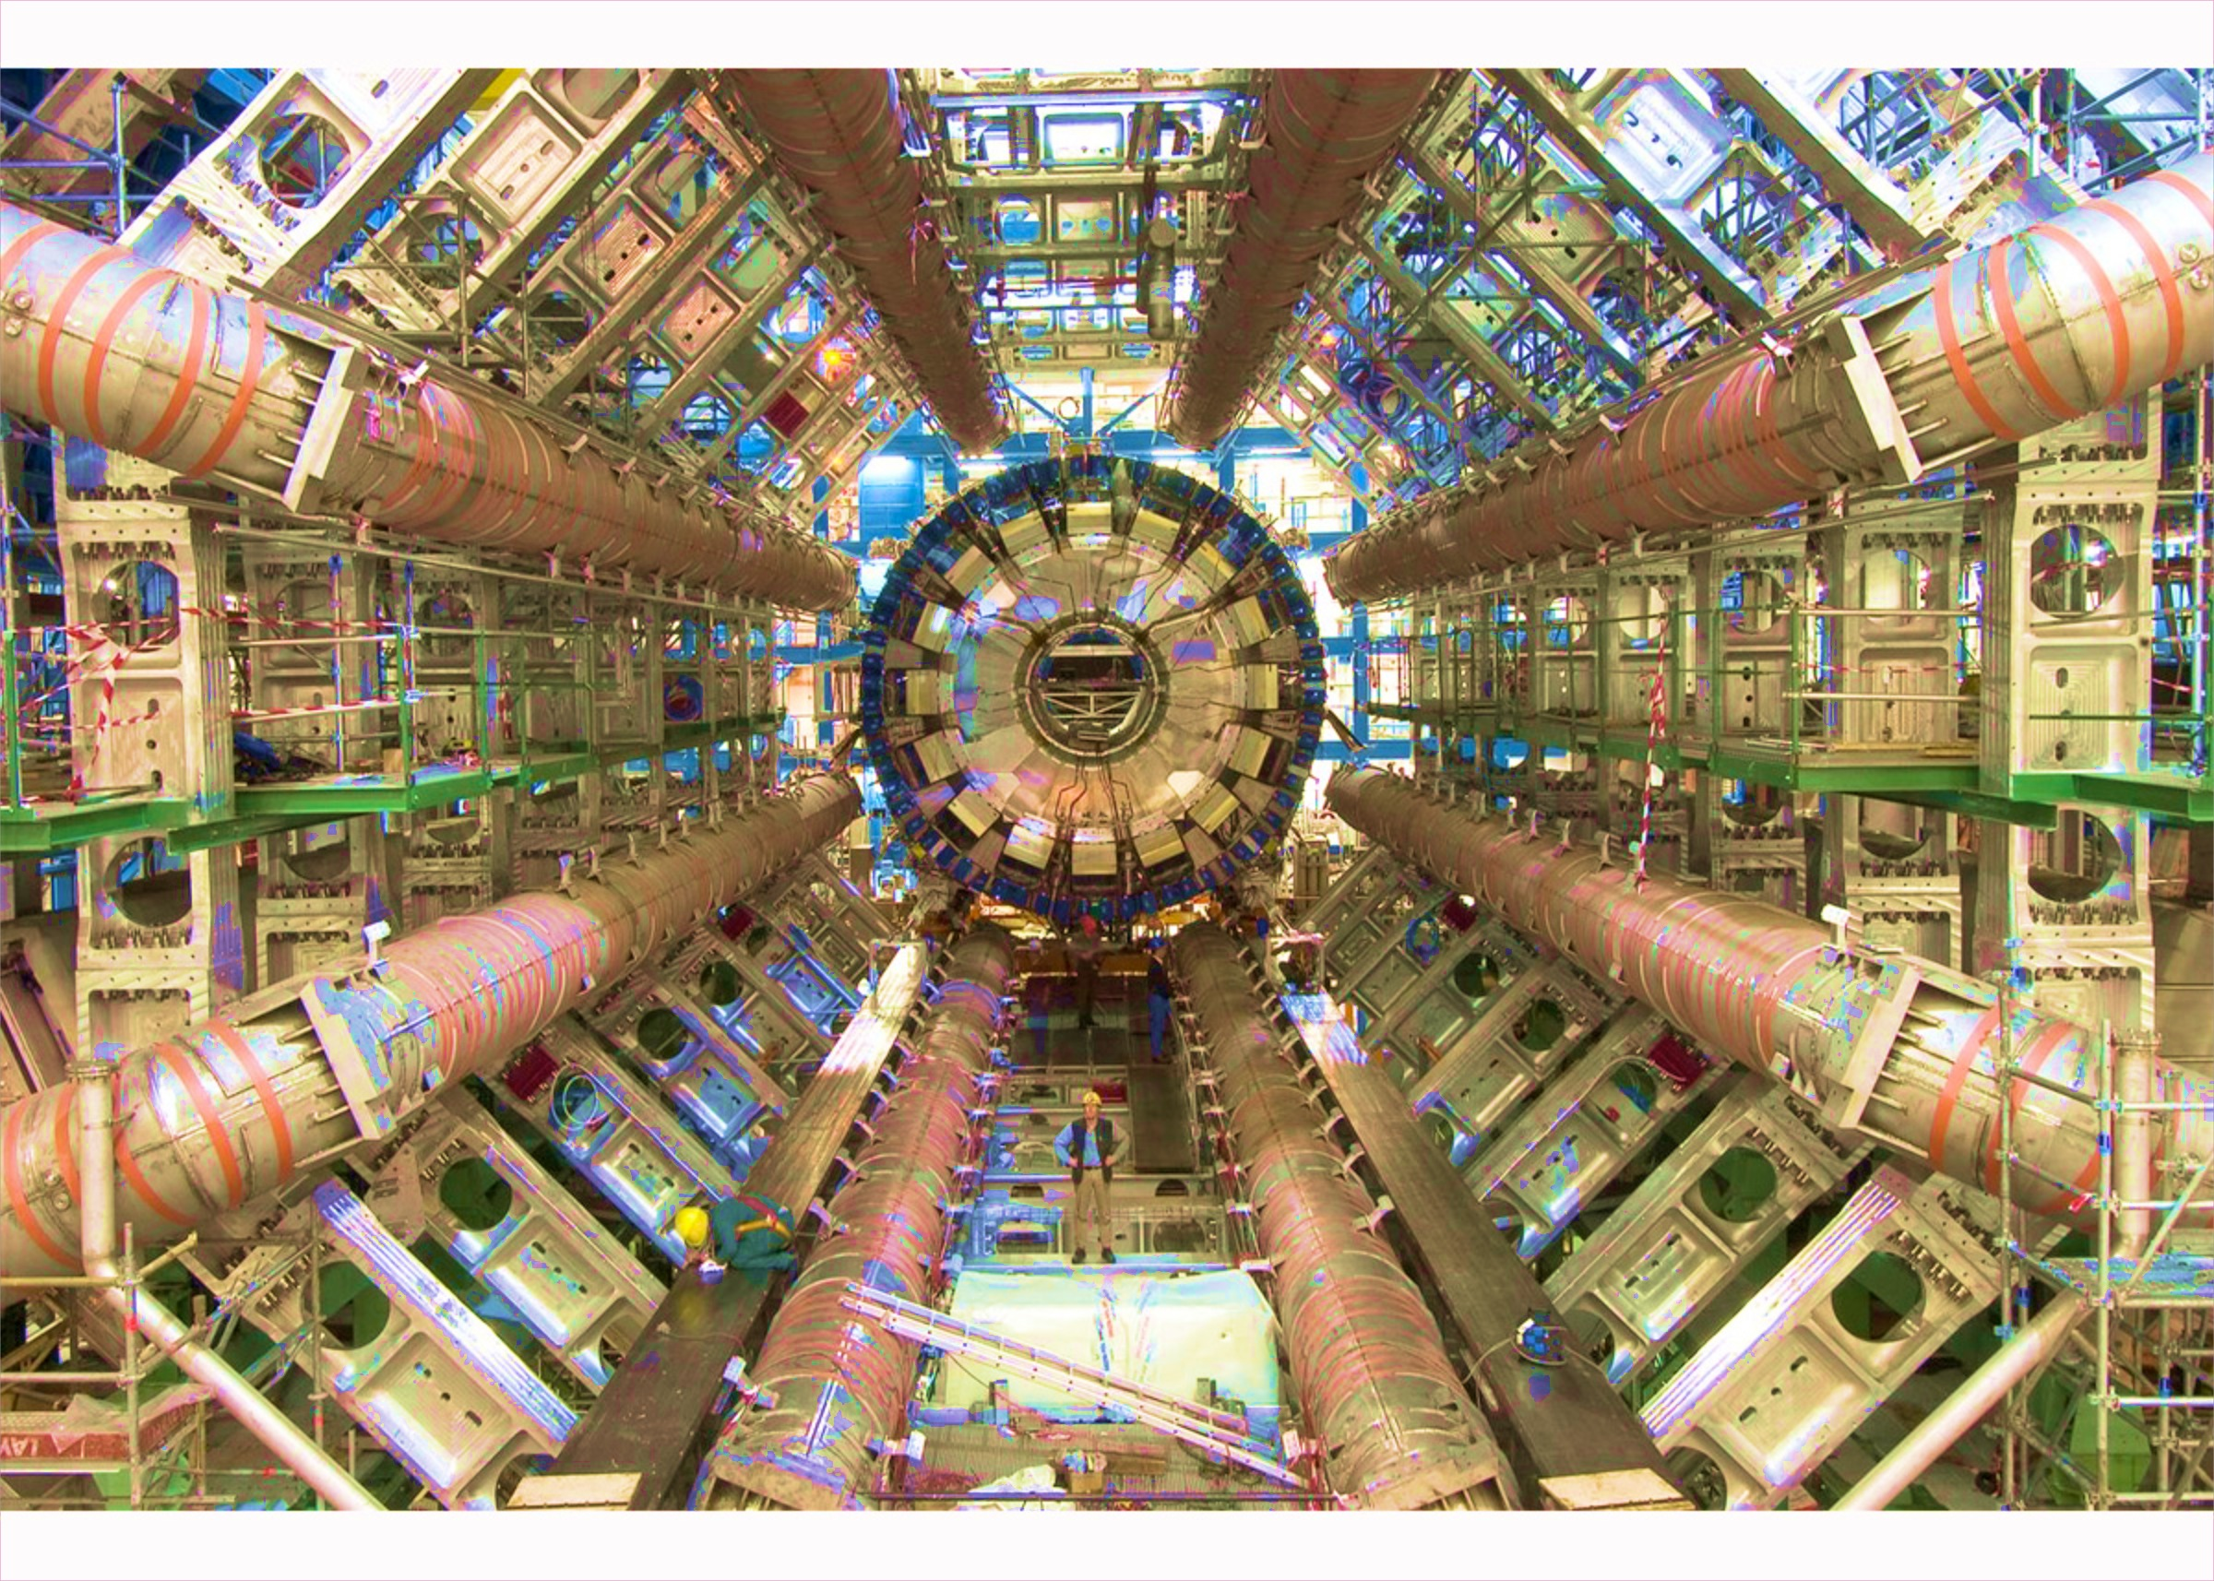
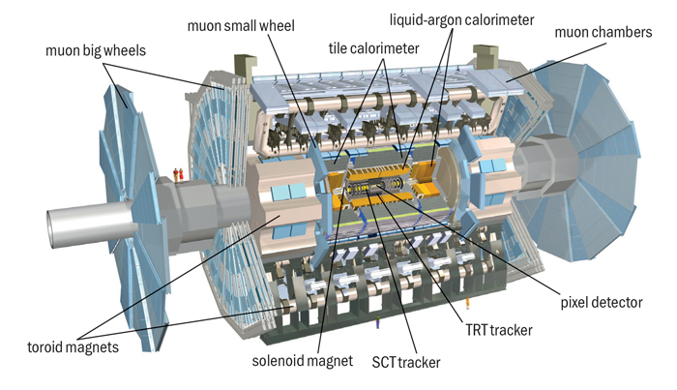
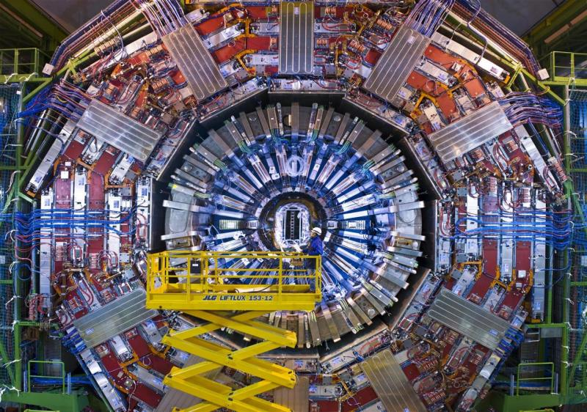
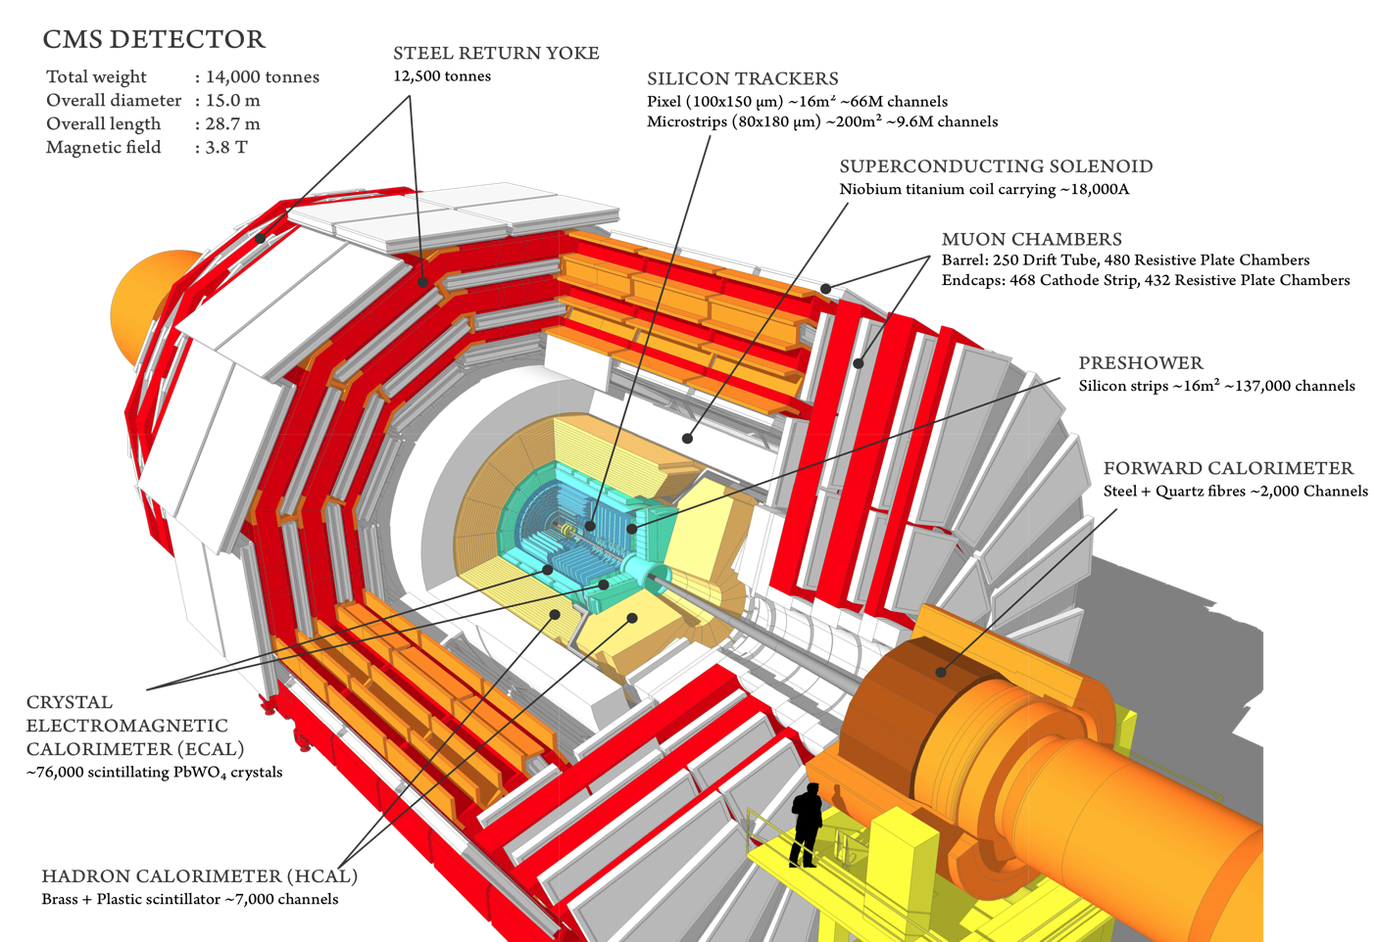
Looking for answers: the LHC
The LHC is a proton-proton collider at CERN, in operation since 2010, occupying the LEP tunnel, underground between Switzerland and France
Two general-purpose experiments: ATLAS and CMS, aim to answer some of these questions [and maybe unveil more unknowns!]
* Will focus on this one!

Slide 8
Finding new physics at the LHC
A full program of searches is ongoing at the LHC experiments directly targeting an impressive number of scenarios
Top quarks and Higgs bosons could be the gateway to new physics at the LHC in two ways
BSM scenarios in which they appear, separately or together that will be explored experimentally
Rare decays, heavy resonances decaying to top or/and Higgs, new particles produced together with top or/and Higgs, exotic partners…
Precision measurements of properties
Test the compatibility with the SM predictions

Slide 9
Outline of the talk
Run-1
Top physics → precision regime, exploring rare processes
single top tW observation
Higgs physics → discovery and first properties
spin analysis H→WW
Top and Higgs physics → early results
ttH, tHq
Run-2
First results
Single top as SM candle
First Higgs plots:
ttH and ggH, H→WW
What lays ahead?
Higgs/top for the next months/years

Slide 10
LHC Run-1

Slide 11
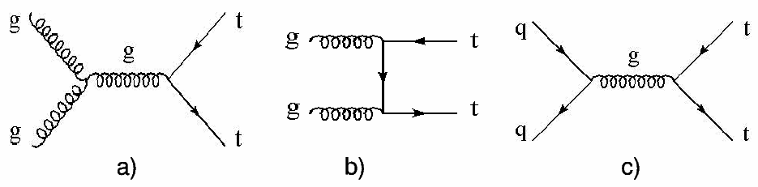
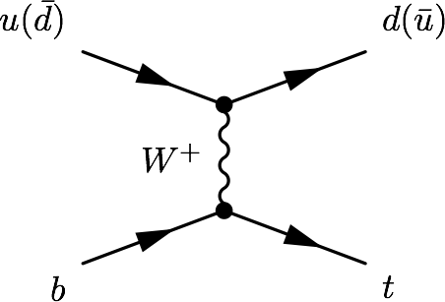
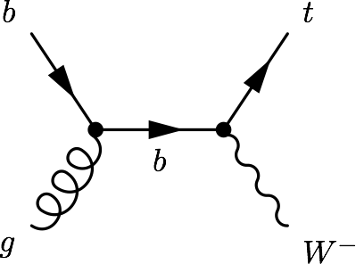
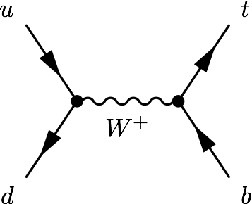
The top factory
The LHC has been competitive with the Tevatron legacy in top phyiscs since the start of the data taking
At the LHC, top quarks are produced mainly in ttbar pairs → strong interaction
Alternative mode, at a lower rate: Single top quark production→ EWK interaction
“The LHC is a top quark factory!”
- Every speaker at every talk about top quarks at the LHC
tW
t-channel
s-channel

Slide 12
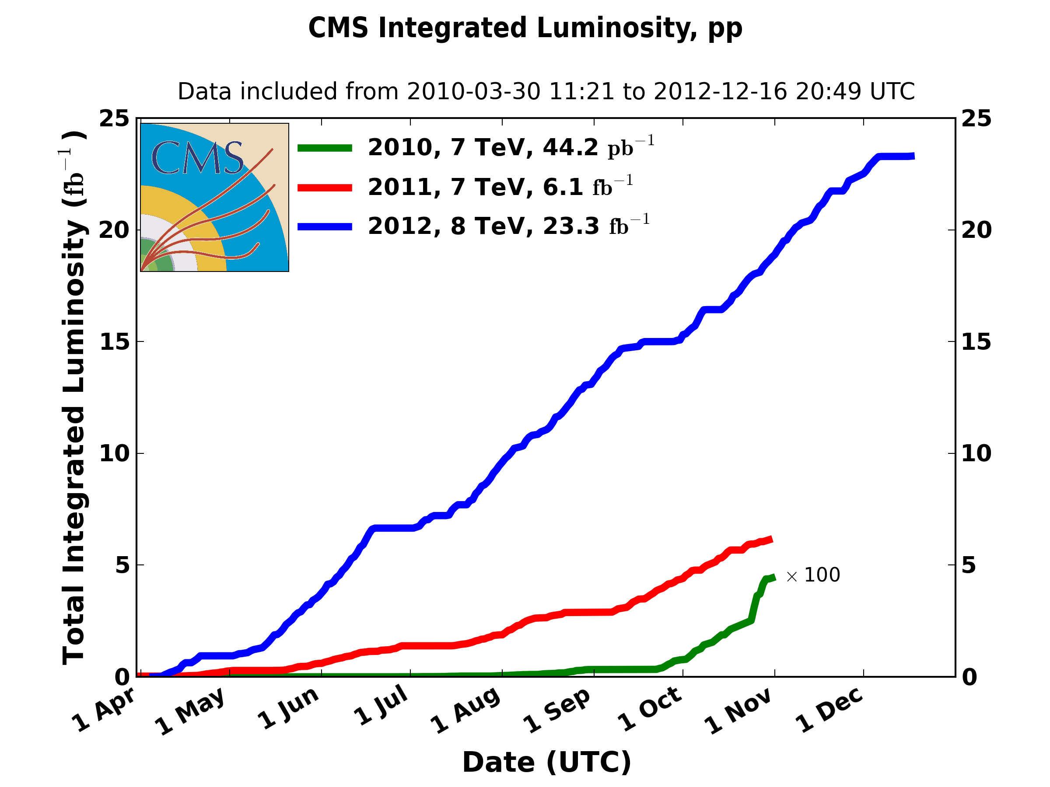
The top factory, in numbers
σ [pb] | ttbar | t-channel | tW | s-channel
Tevatron (1.96TeV) | 7.08 | 2.08 | 0.22 | 1.046
LHC @ 7TeV | 177.31 | 63.89 | 15.74 | 4.29
LHC @ 8TeV | 252.89 | 84.69 | 22.2 | 5.24
LHC @ 13TeV | 831.76 | 216.99 | 71.2 | 10.32
Run-1 of the LHC lasted three years:
~5fb⁻¹ of pp collisions at 7TeV
~20fb⁻¹ at 8TeV
CMS then registered
More than 5M ttbar pairs
Around 2M of single top quarks via t-channel
Half a million of tW events
a bit more than 100K of s-channel events

Slide 13
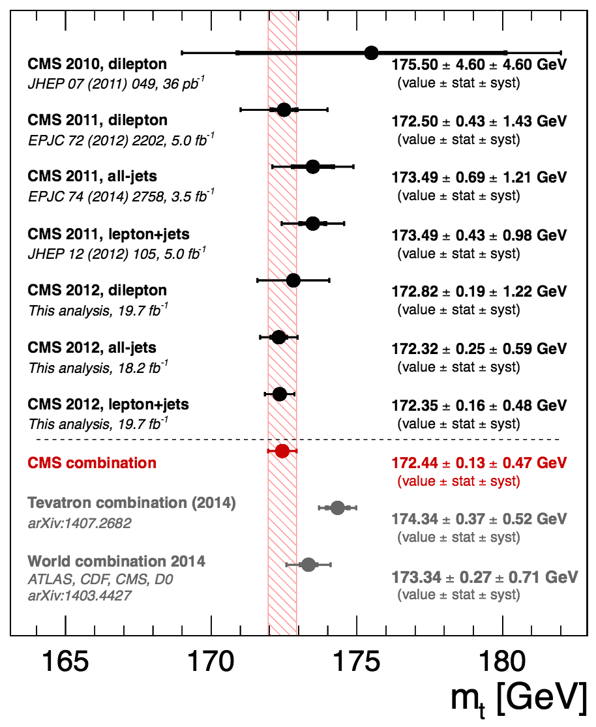
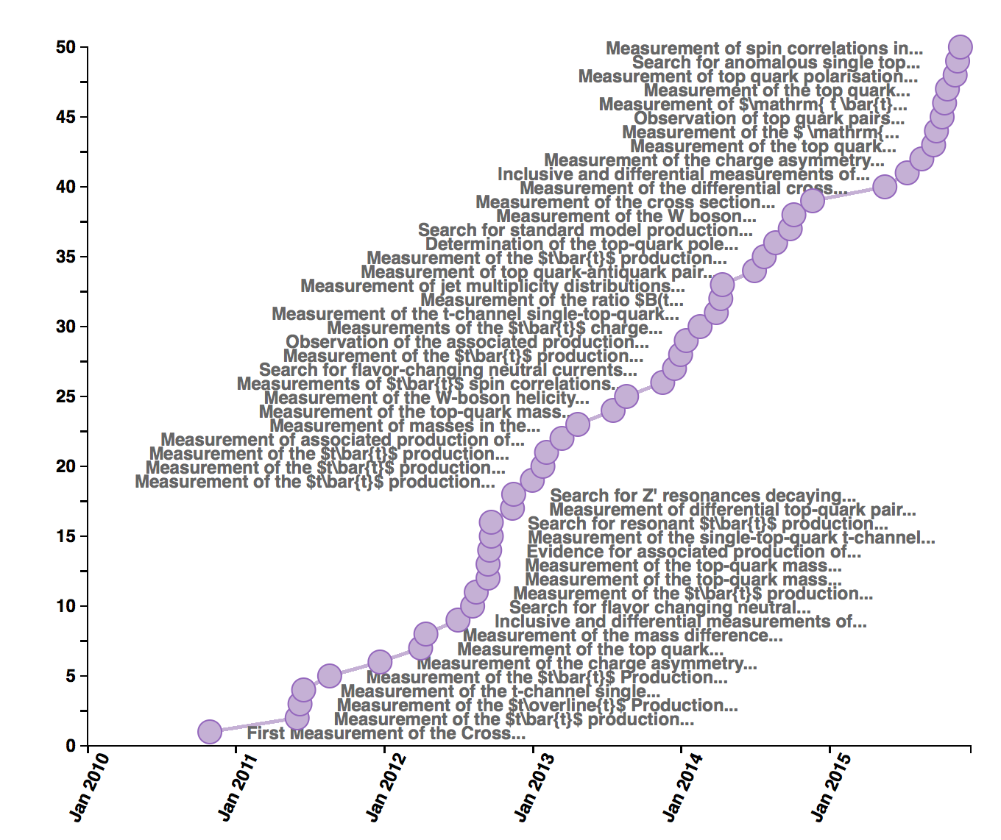
Top results
50 top papers submitted to journals, 49 of them at 7/8 TeV
High precision regime → most precise mass measurement to date (±0.48 GeV)
It would be the topic for a full talk (or several)
→ Let’s focus on one kind of process that illustrates well the potential of the LHC for top physics

Slide 14
Single top physics
Single top production was observed for the first time also at the Tevatron (2009)
But it was still largely unexplored when the LHC started
Rediscovery in 2010, first LHC single top papers in 2011
Today, all single top processes have been established (the Tevatron data allowed for observation of the s-channel, after shutdown, in 2014)
The pioneering times are over → entering precision physics, several properties already studied in t-channel production
Single top processes are very sensitive to BSM effects
→ so far everything in agreement with SM predictions
2009 - Single top discovery
2011 – First LHC single top paper
1986 - Tevatron starts colliding
1995 - Top quark discovery
2010 - LHC starts colliding

Slide 15
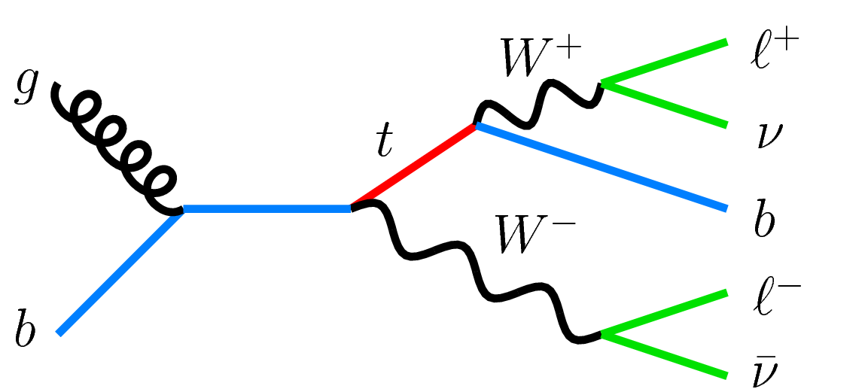
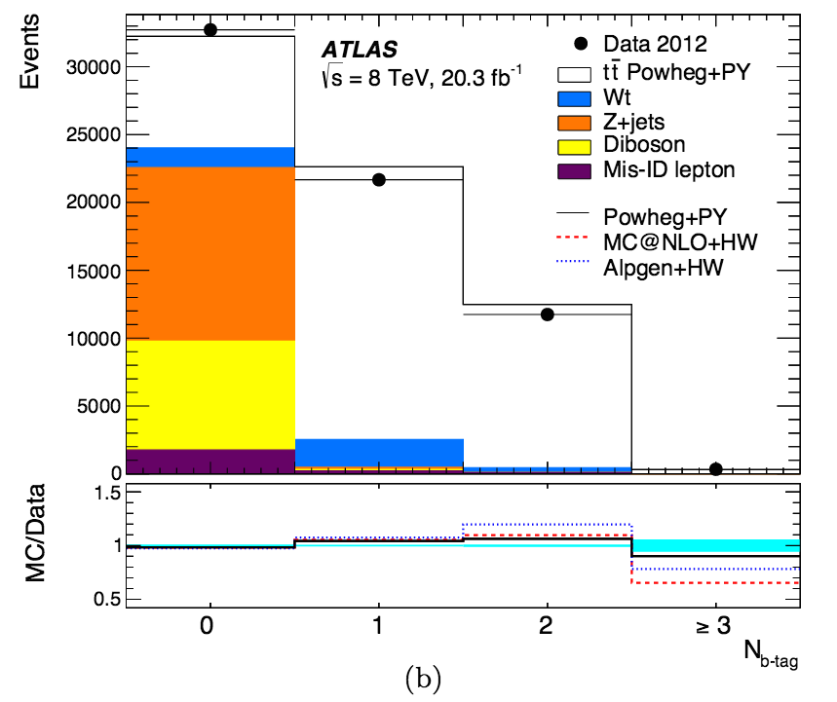
tW associated production
This process could not be studied at the Tevatron, since its production rate was very low, but it is the second most common single top process at the LHC
Dilepton final state:
2 opposite sign leptons
Missing transverse energy due to the neutrinos
One jet coming from a b-decay
Main background: tt production
But it is a main background on its own of:
H→ WW →2l2ν
tt →2l2ν2b

Slide 16
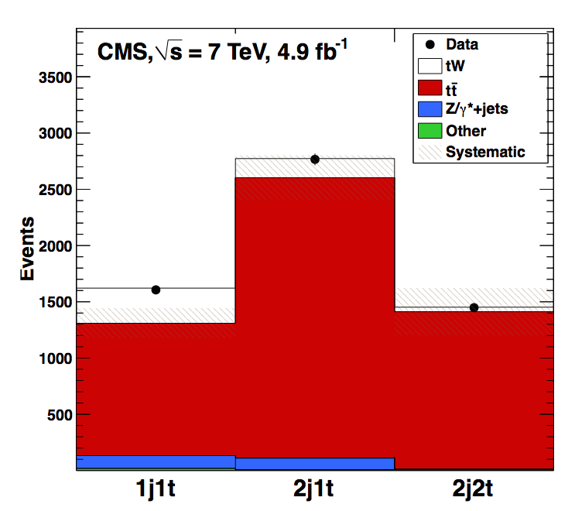
tW at 7TeV
At 7 TeV, with the full luminosity recorded (4.9fb⁻¹) → analysis statistically limited
Final states with electrons and/or muons
Signal region (events with one b-tagged jet) supported by two control regions enriched in tt background designed to constrain this background:
2 jets, one of them b-tagged
2 jets, both of them b-tagged
Analysis based on a BDT (tW Vs. tt)
cut-based analysis as cross-check
Significance of 4.0σ → strong evidence
Phys. Rev. Lett. 110 (2013) 022003
arXiv:1209.3489

Slide 17
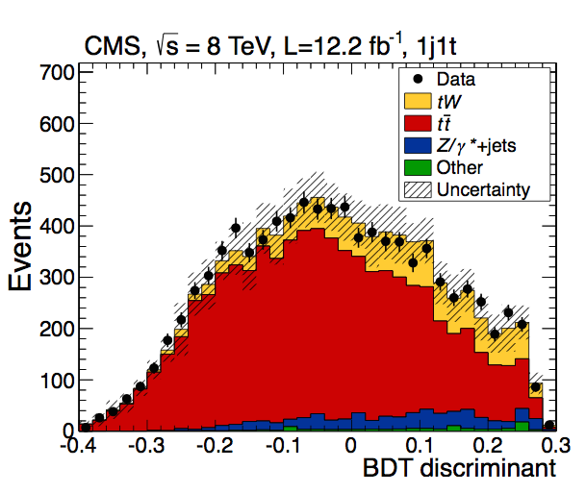
tW at 8TeV
At 8 TeV, the analysis is no longer limited by statistics (12.2fb⁻¹)
A more sophisticated BDT (cross-checked with a cut-based analysis, and a shape-based analysis)
The same control regions were used
The key to a better sensitivity was the use of ‘loose’ jets
The main uncertainties come from theory modeling of tt
6.1σ → Observation
Phys. Rev. Lett. 112 (2014) 231802
arXiv:1401.2942

Slide 18
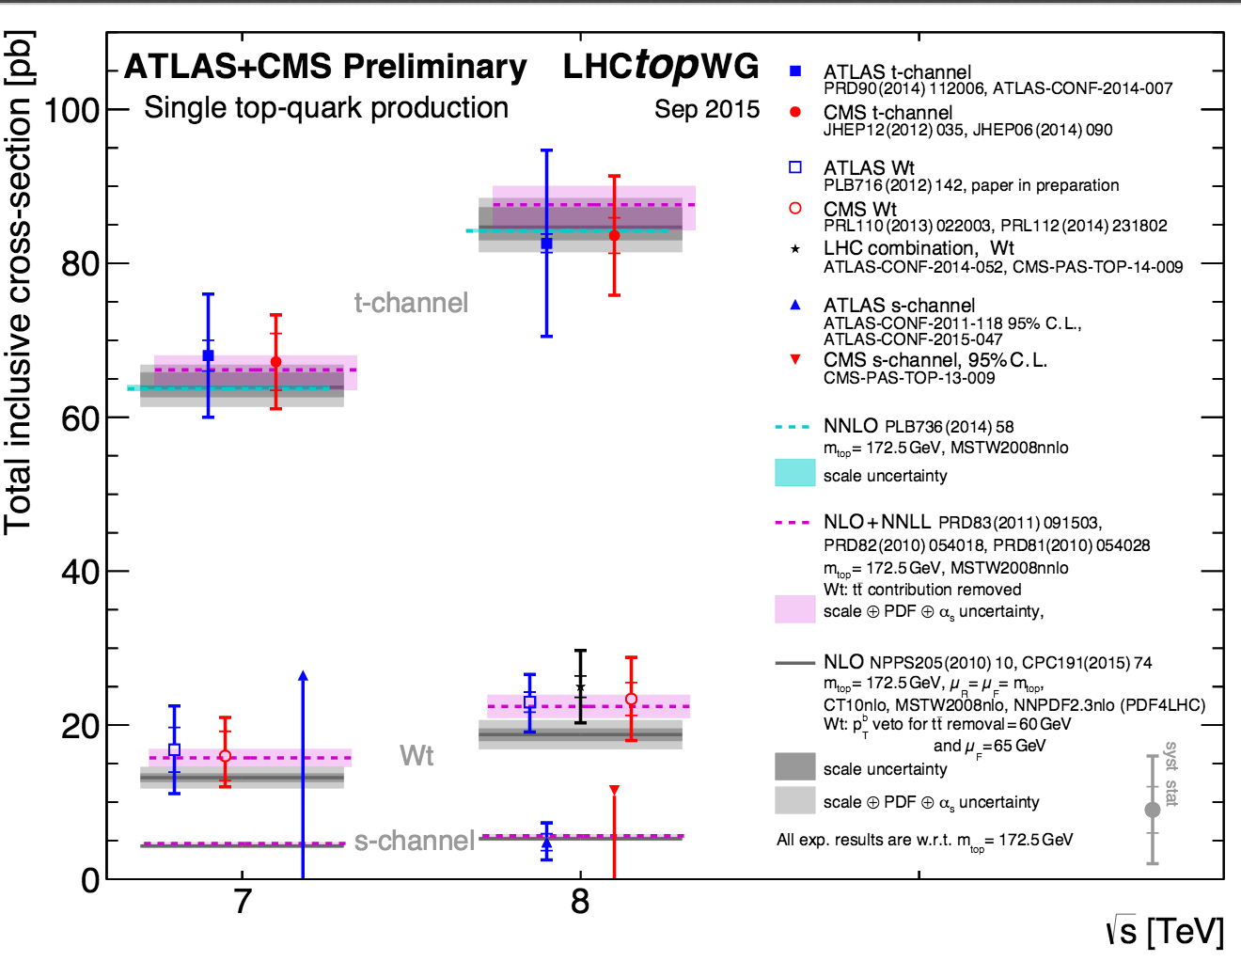
Run-1 single top wrap-up
The tW cross sections obtained at 7 and 8TeV, as well as the t- and s-channel measurements, are in good agreement with the SM expectations
During Run-1 the first properties were measured in t-channel events (top polarization, W helicities, |V_{tb}|..), and searches for FCNC (tZq, tγq) and anomalous couplings were performed

Slide 19
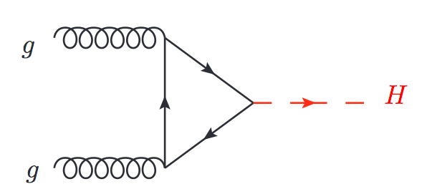
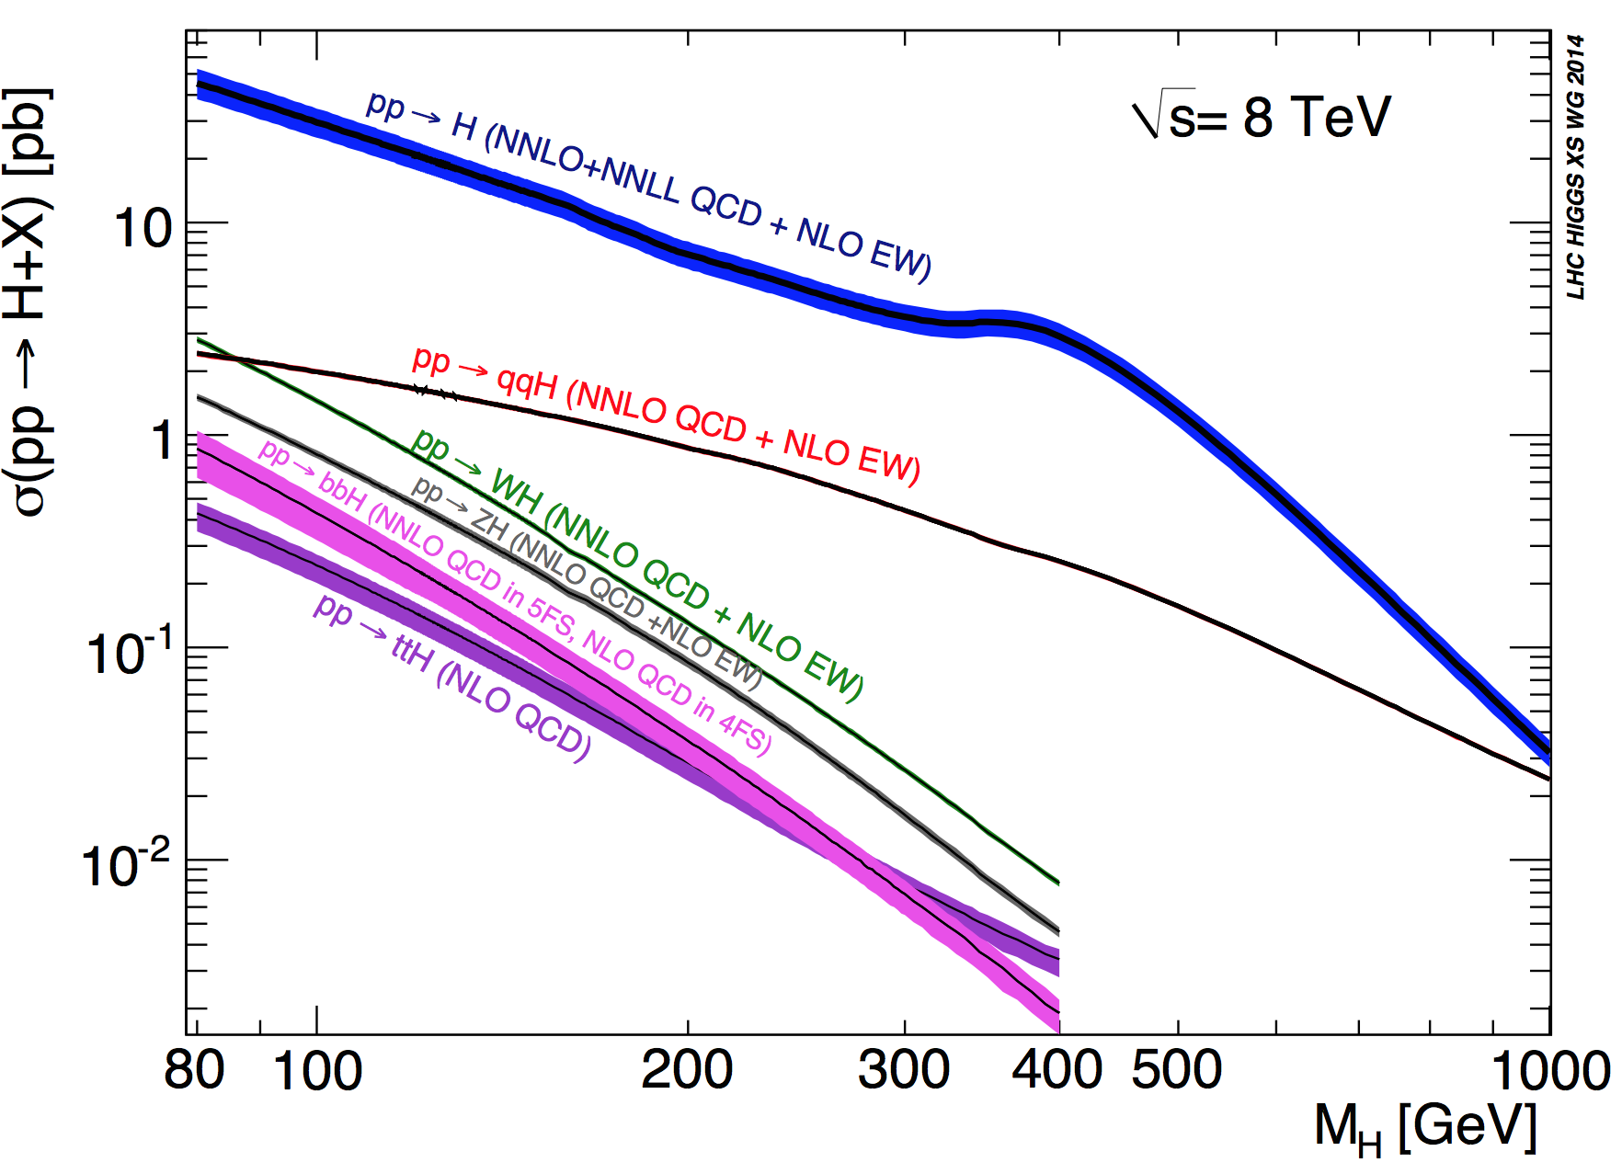
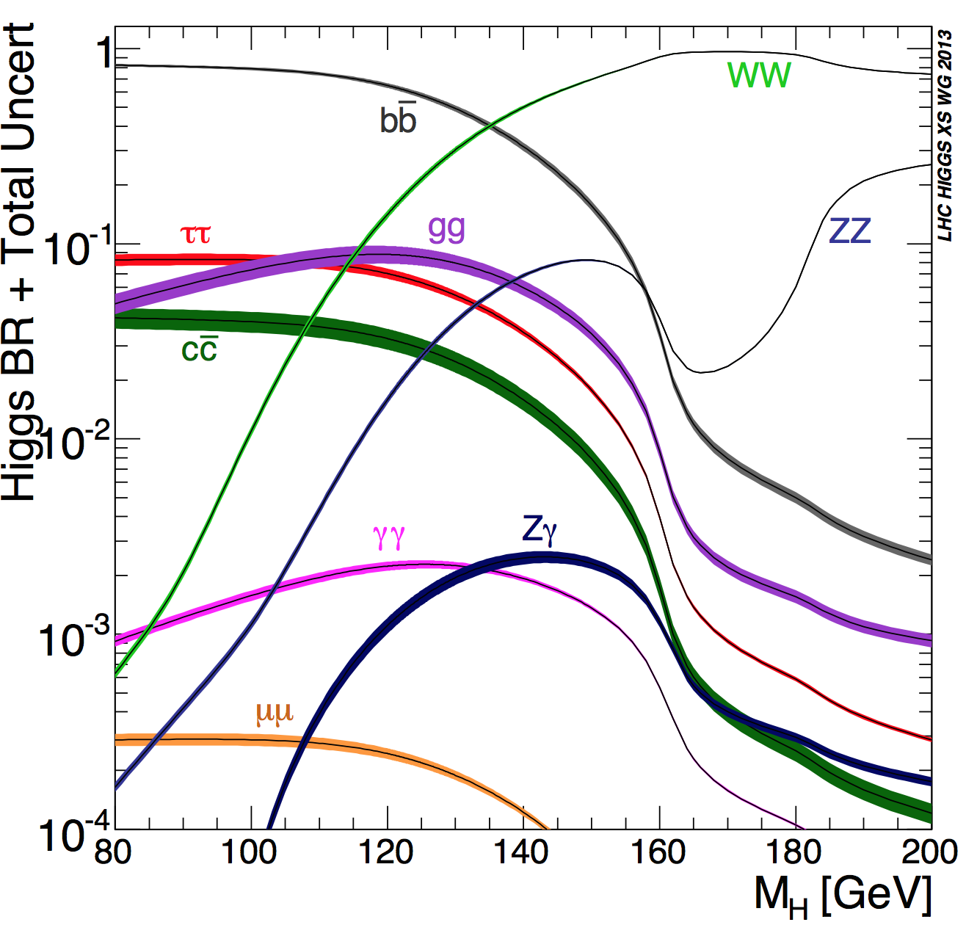
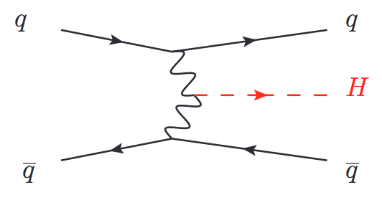
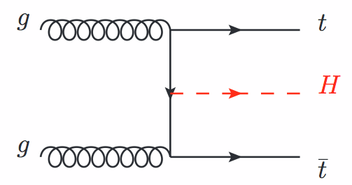
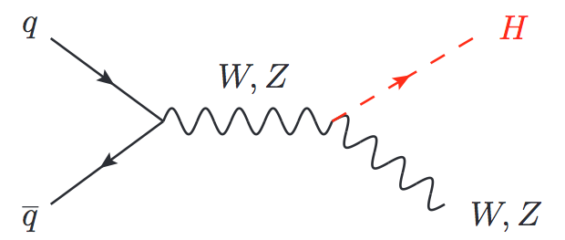
Searching for the Higgs
Meanwhile, at the start of the Run-1 we looked for the Higgs everywhere
Production and decay modes determined by the mass of the Higgs
We performed a full mass scan from the LEP limit of 114.4 until above 600GeV
We found it with a mass of ~125GeV

Slide 20
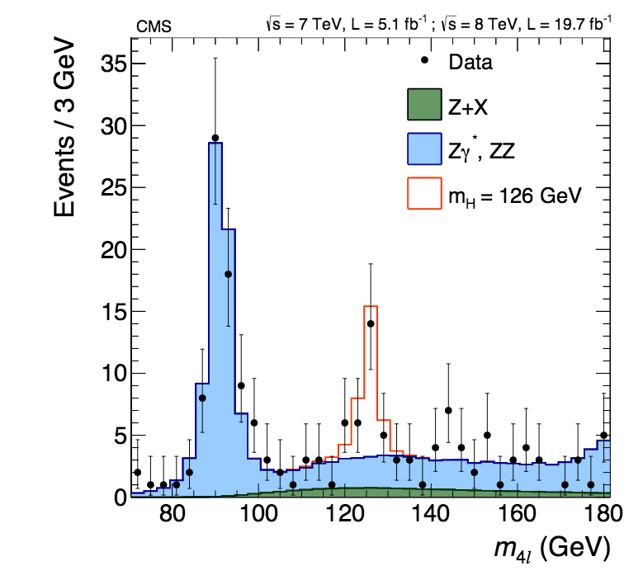
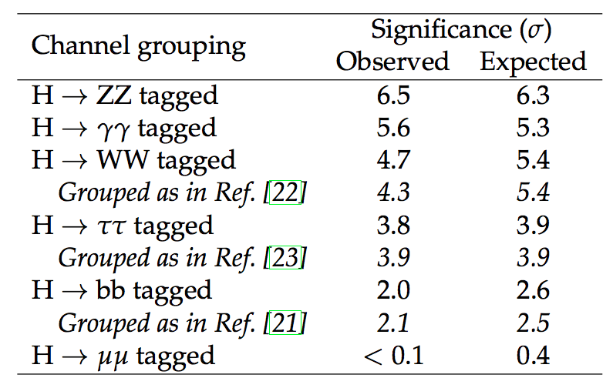
Higgs channels
We observe it with different levels of confidence, in a variety of decay channels, exploiting all possible production modes
arXiv:1412.8662
Observed and median expected significances of the excesses for each decay mode

Slide 21
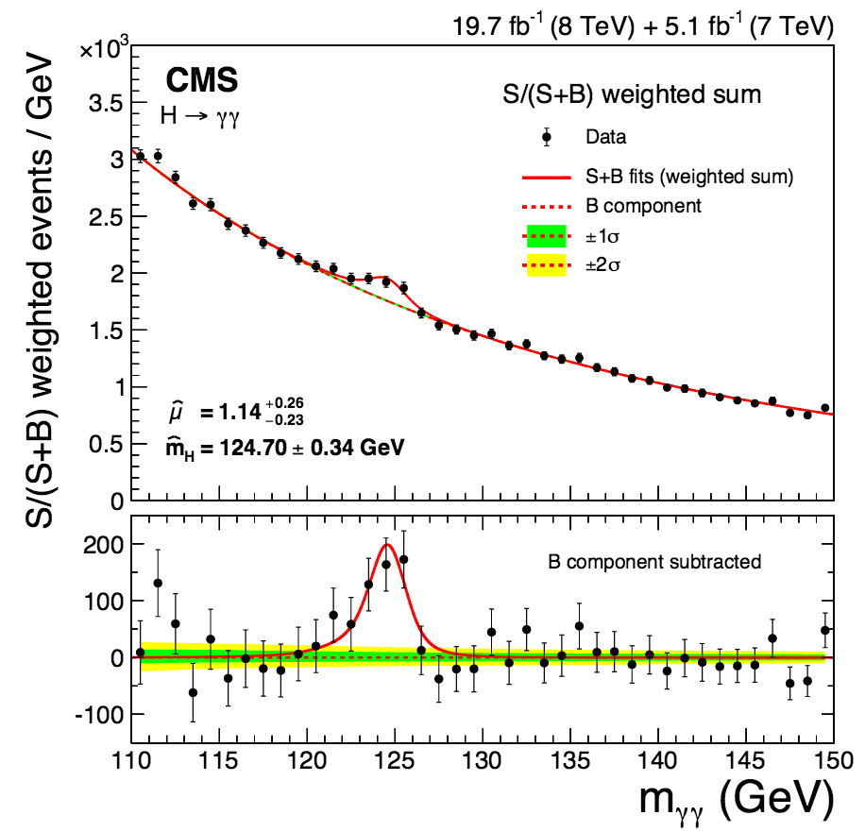
Higgs channels
We observe it with different levels of confidence, in a variety of decay channels, exploiting all possible production modes
arXiv:1412.8662
Observed and median expected significances of the excesses for each decay mode

Slide 22
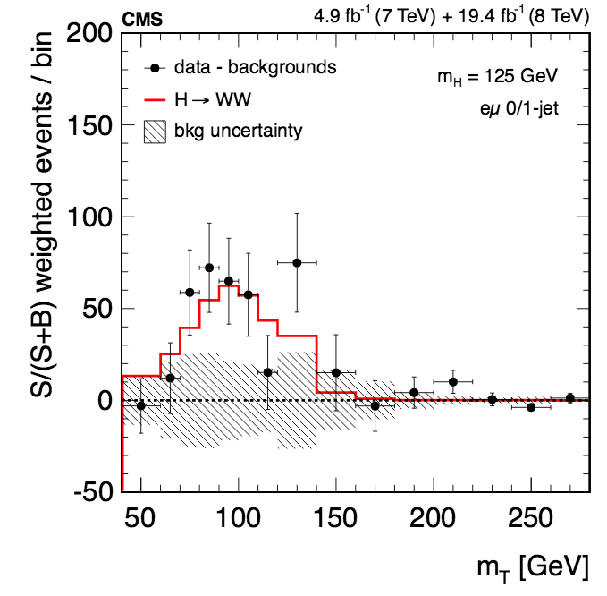
Higgs channels
We observe it with different levels of confidence, in a variety of decay channels, exploiting all possible production modes
* Will focus on this one!
arXiv:1412.8662
Observed and median expected significances of the excesses for each decay mode

Slide 23
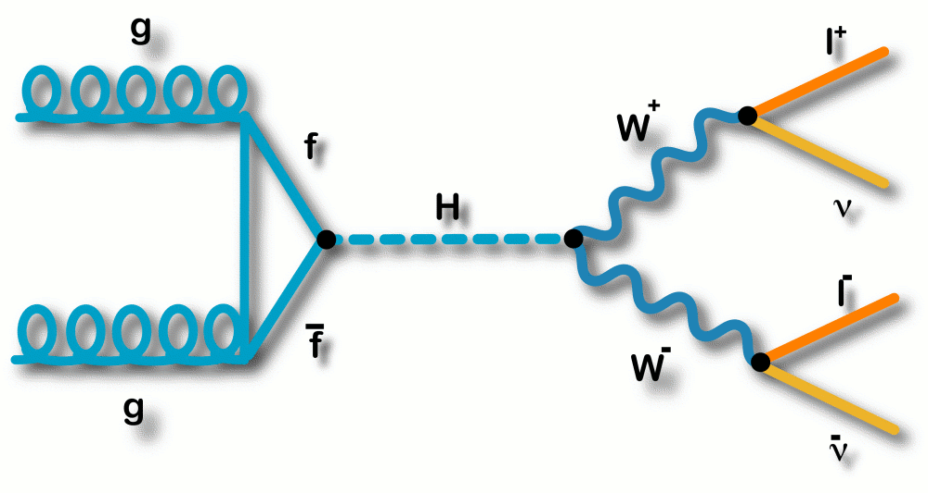
H→WW→ 2l2ν
Sensitive in the intermediate mass range [120-200]
2^{d} largest BR around 125 GeV → BR _{H→WW} ~ 22%
Clear signature in leptonic decays (BR_{W→lν} ~ 10%)
Depending on the production mode: little to no jet activity (ggH), 2 forward jets (VBF)
other production modes (VH, ttH) provide even more specific signatures
No mass peak, not possible to reconstruct full final state → neutrinos
Large background contribution (genuine and instrumental):
WW (irreducible), top, Drell-Yan, W+jets, QCD…
Two leptons (e,µ) with opposite charge
Substantial missing energy

Slide 24
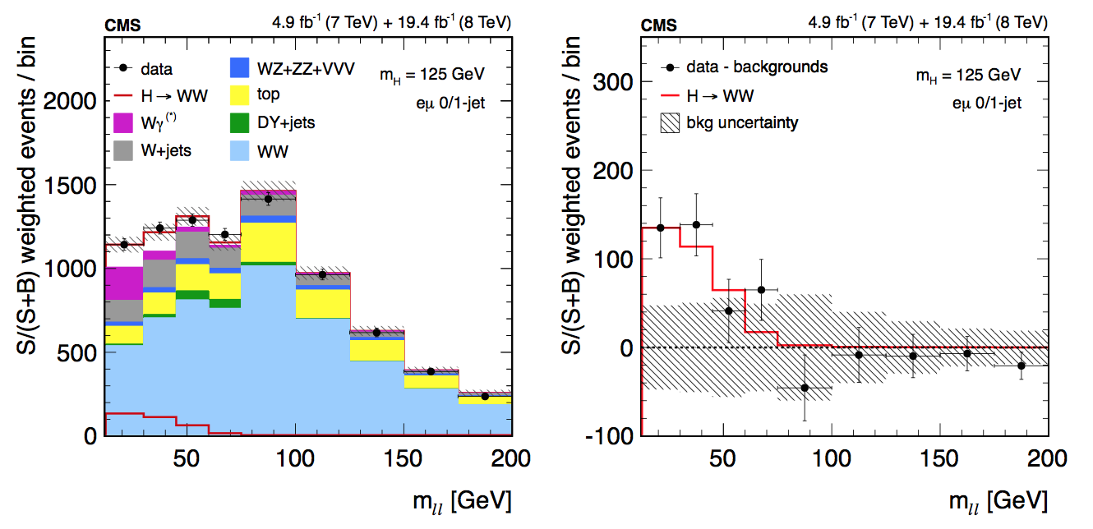
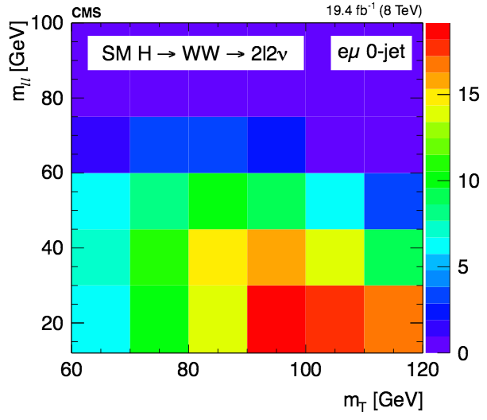
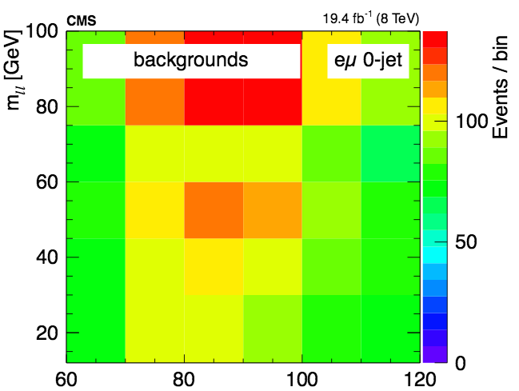
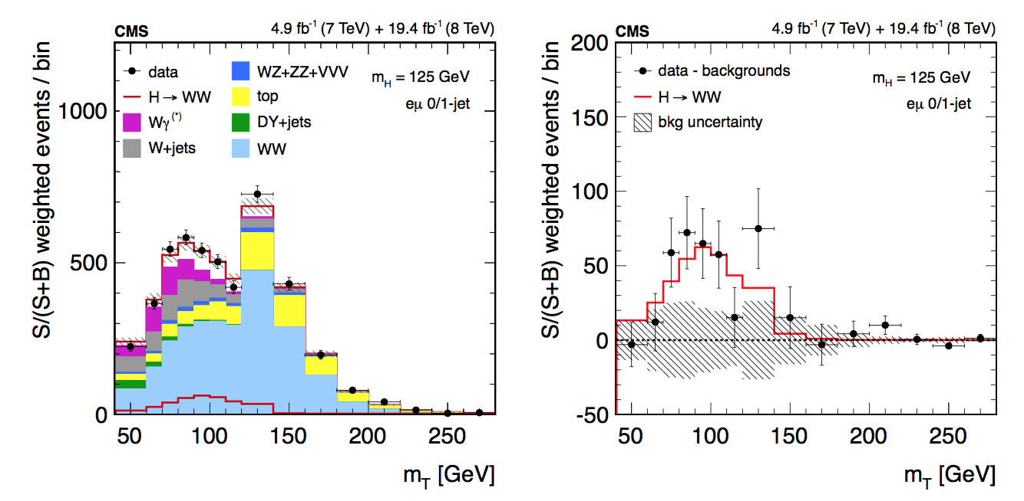
H→WW→ 2l2ν analysis
Performed in categories with different approaches depending on production mode and the flavor (and charge) of the leptons
ggH, VBF, WH, ZH
The eµ ggH analysis (0,1 jets) is the most sensitive
on its own achieves a sensitivity of > 4σ
2D shape analysis: m_{T} – m_{ll} distributions
JHEP 01 (2014) 096
arXiv:1312.1129

Slide 25



Higgs properties
After the discovery the next step is to precisely measure the properties of the new particle to confirm it is (or not) the SM Higgs
Charge (easiest), Couplings, Spin, Parity, Mass, Width…
Some of the first measurements come together with the searches → dedicated studies followed right after
How much was explored already with Run-1 data?
Reality?
SM prediction
Reality?

Slide 26
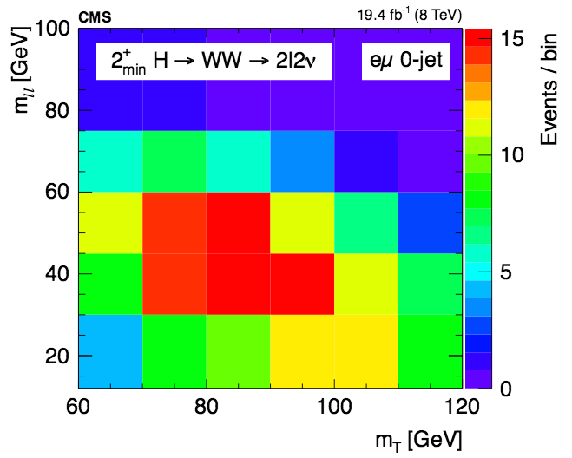
Spin and tensor structure in H→VV decays
(V=Z,W,γ)
Done via the study of the kinematic distributions of the decay products, which are determined by the tensor structure of the HVV interactions
The strategy in each channel depends on the number of kinematic variables available → is given by the decay of the Higgs
H→ZZ→4l: Full kinematic information accessible
H→WW→eµ2ν: limited sensitivity due to the neutrinos in the final state
The H→WW analysis templates are optimal to discriminate against different spin hypothesis
Phys. Rev. D 92, 012004 (2015)
arXiv:1411.3441

Slide 27
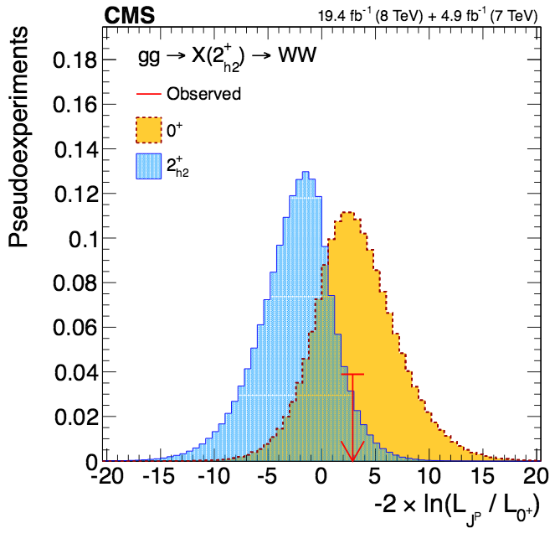
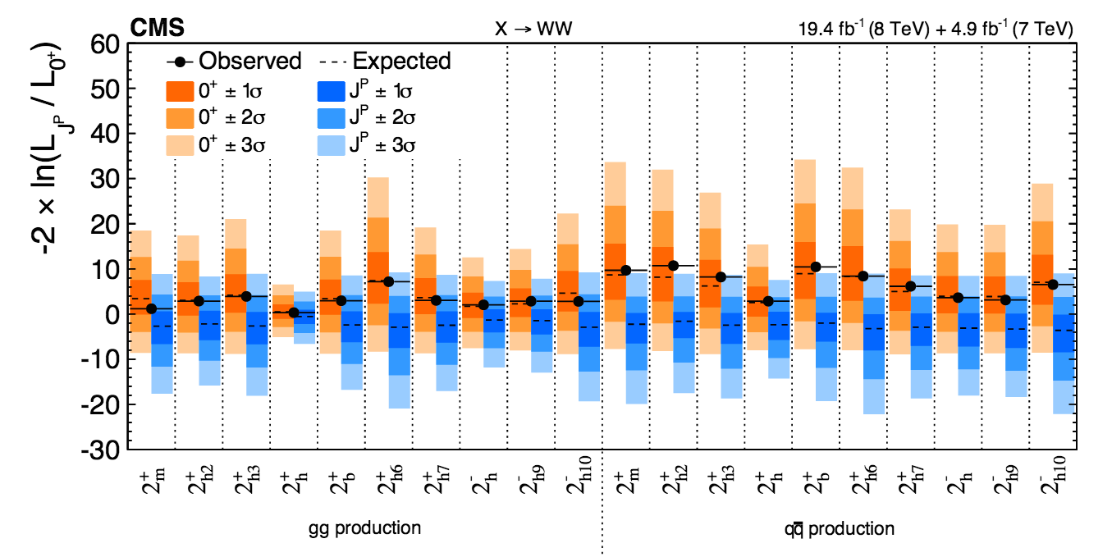
Exotic spin
Different BSM spin and CP hypotheses tested using H→WW decays
→ Exotic spin-1 or spin-2, BSM 0⁻ 0⁺_{h}

Slide 28
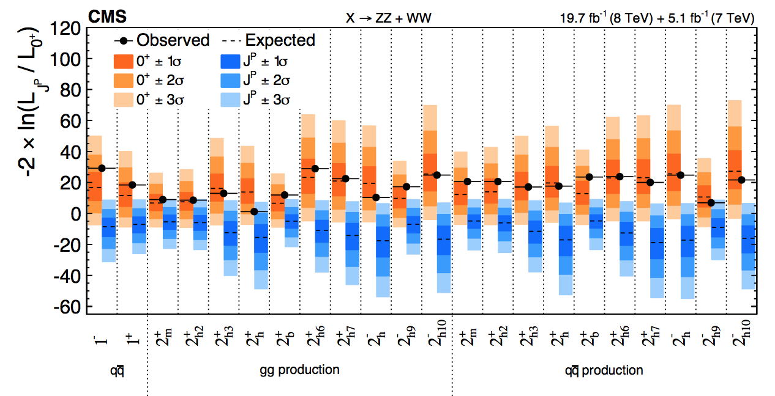
Exotic spin: combination
It is in the combination with H→ZZ when the best sensitivity is achieved:
All spin-1 hypotheses excluded at > 99.999% CL , Spin-2 boson 2⁺_{m}, excluded at a 99.87% CL, other spin-2 hypotheses excluded at a ≥ 99% CL
Spin 0 particle favored

Slide 29
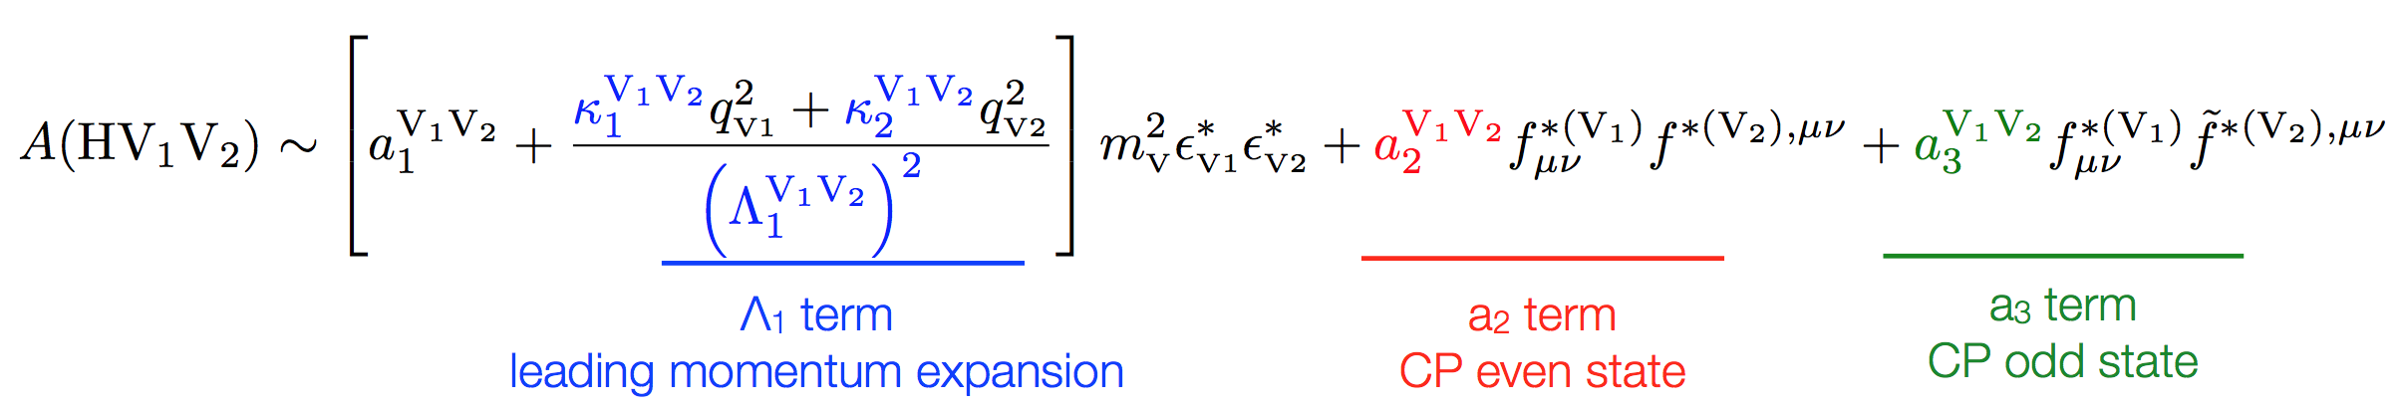
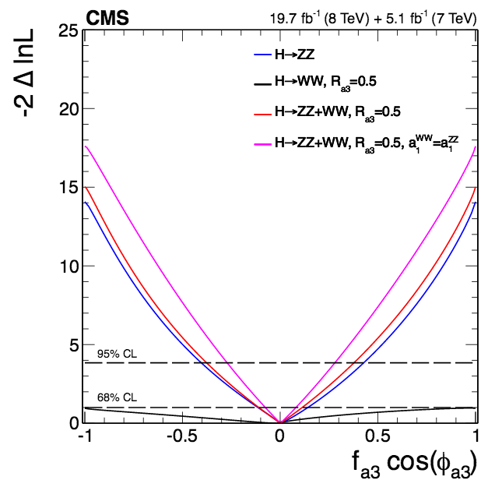
Spin-0
Once the exotic spin is ruled out → study of the tensor structure of the HVV interactions under spin-0 assumption
The decay amplitude for a spin-0 boson to a pair of V bosons can be written as:
We use a parameterization that relates the anomalous couplings coefficients: a₂, a₃, and Λ₁ to cross sections fractions (f_{a2}, f_{a3}, f_{Λ1})
The analysis sets limits on anomalous couplings by performing likelihood scans of the three effective fractions
Full set of scans in ZZ and WW decays
All consistent with the SM

Slide 30


Summary of anomalous couplings
Allowed confidence level intervals for anomalous coupling parameters assuming real coupling ratios (π or 0)
Assuming custodial symmetry: pure 0_{h}⁺ (related to f_{a2}) excluded at 99.93% CL and pure 0⁻ (pseudoscalar, related to f_{a3}) excluded at 99.99% CL

Slide 31


Mass and compatibility with the SM
Under the spin-0 assumption
Combined CMS and LHC Higgs measurements
The couplings to massive vector bosons and fermions are also explored
arXiv:1412.8662
arXiv:1503.07589
 | CMS combination | LHC combination
m_{H} (γγ , ZZ) [GeV] | 125.02 +0.26 (stat) +0.14 (syst) | 125.09±0.21(stat) ±0.11(syst)
σ/σ_{SM} | 1.00 ± 0.09 (stat) +0.08 (theo) ± 0.07 (syst) | 1.09±0.11
CMS-PAS-HIG-15-002
Looks very much like a SM Higgs so far…
But only more data will tell

Slide 32


Top and Higgs: Yukawa coupling
The top-Higgs coupling is very strong in the SM, and because the top is heavier than the Higgs → it cannot be assessed by measuring Higgs decays to top quark pairs
It can be experimentally constrained in gluon fusion production → happens via a fermion loop, top provides the dominant contribution -assuming no new physics is contributing to the loop
And in H→γγ decay: proceeds through a top loop and a W loop
Within uncertainties, current measurements are so far consistent with the SM expectations
Probing the top-Higgs Yukawa coupling directly requires a process that results in both a Higgs boson and top quarks explicitly reconstructed via their final-state decay products

Slide 33

ttH associated production
SM Higgs production process that does not happen often:
It is the sixth process in terms of cross section at the LHC → 0.13pb at 8TeV
But when it does, it is flashy:
Final states with a Higgs decay and two tops → [Higgs decay]+WW+bb
Busy signatures: b-tagging, boosted objects, many leptons…
With Run-1 data, we have studied this production in many channels
H→bb
H → γγ
H→WW (with 2, 3, and 4 leptons)
H→ZZ
H → ττ
arXiv:1408.1682

Slide 34



ttH associated production: results
All channels are statistically limited, no statement can be said regarding ttH production with Run-1 data, but limits are set
All the channels combined give a best-fit value for the signal strength of 2.8 → excess above background-only of 3.4 standard deviations
2σ upward deviation with respect to the SM prediction
driven by ttH multilepton in H→WW

Slide 35


tHq associated production
However, the only process in which top and Higgs are produced together sensitive to the sign of the top-Higgs coupling is single top plus Higgs production (tHq)
tHq is highly suppressed in the SM
0.018 pb at 8TeV
However, its production rate could be affected by anomalous top-Higgs couplings
For example: a negative value of the coupling would increase the tHq cross section x15

Slide 36


tHq associated production
tHq production has very characteristic signatures:
Higgs decay, top decay (b-tagging), and a forward light jet (single top t-channel handle)
Studied in Run-1, in almost as many channels as ttH:
H→bb, H → γγ , H→WW, H → ττ
Submitted to JHEP
arXiv:1509.08159

Slide 37

Single top + Higgs: Results
The sensitivity to a SM tHq will not be reached until well into Run-2 (or 3)
But sensitivity to a negative coupling will arrive much earlier
A large rate of single top plus Higgs events could mean different BSM effects (FCNH, decay of new heavy particles)
Moreover:
Negative values of k_{f} are disfavored with the current data → under the assumption that no new particles contribute to the ggH and H→γγ loops, and that there are no BSM decays

Slide 38

LHC Run-2

Slide 39


Current status of the LHC
In 2015 the LHC started running again, entering a new energy regime → the pp run at 13TeV ended Nov. 4th
Though the full potential of Run-2 is still ahead, the LHC already delivered 4fb⁻¹ of integrated luminosity
The first Run-2 results are arriving
CMS-PAS-TOP-15-004
Already with 42pb⁻¹ → single top cross section was measured in the t-channel
Single top production: Once a rare top production mode, has became a SM candle

Slide 40




Work is ongoing in H→WW too
First public 13TeV ggH, H→WW distributions
Control regions of two main backgrounds
Presented this Tuesday (Dec. 15th):
https://indico.cern.ch/event/442432/
The amount of collected luminosity will not allow for rediscovery in this decay before the 2016 data, but the basis of the Run-2 analysis will be set
tt enriched region
WW enriched region

Slide 41



As in ttH, H→WW
The ttH, H→WW analysis (multilepton with 2,3, and 4 leptons) uses a multivariate discriminant to separate leptons from tt and ttH events
Distributions of the discriminants in different control regions → first 13TeV ttH plots also presented Tuesday:
https://indico.cern.ch/event/442432/

Slide 42

What’s next?

Slide 43

Next steps for Higgs
During Run-2 we aim to collect ~100fb⁻¹ (~300 fb⁻¹ by the end of Run-3)
σ₁₃/σ₈: few fb⁻¹ at 13TeV could be more sensitive than the full dataset at 8 TeV
Run-2 and beyond:
Establish the main production mechanisms (ggH, VBF, WH, ZH, ttH) and all possible decay modes
Measure properties
Any deviation in the predicted properties → unambiguous sign of new physics
mass, total width, spin, couplings, CP mixtures
Searches for multiple Higgs bosons, Higgs partners…
Higgs coupling modifications from the SM when new particles have M∼1 TeV
arXiv:1310.8361

Slide 44

H→WW
In particular in H→WW:
Production modes, establish VBF (Run-2), explore VH, ttH (bbH)
Achieve a better sensitivity to anomalous couplings
Study Higgs width, differential distributions, fiducial cross sections
Improve systematics and control of the backgrounds
Top contribution to the 0/1 jet bins → Run-2 study directly linked to tW
Top background in H→WW is a mixture of tt and tW
0-jet bin: ~45% of top is tW
1-jet bin: ~25%

Slide 45

Top physics: state of the art simulation
In the next months, the top sector will be scrutinized in search for new phenomena
The measurement of top properties will continue to be refined
Clear need for an ever improving simulation
top mass, systematics related to modeling
Also other less obvious: single top tW
Single top tW is well described at LO (5FS), but at NLO it mixes with tt
Problematic diagrams are either removed from the signal definition (Diagram Removal) or subtracted using a term (Diagram subtraction)
A full 4FS NLO description of tt, tW and in general non-resonant WWbb will come next year, important to tt and tW, immediate use in H→WW
tt
tW
arXiv:1311.4893

Slide 46

ttH, tH, and top-Higgs coupling
The slight excess hinted in the ttH multilepton (H→WW) will be followed up in the next months
Can be done relatively soon → early analysis, large growth (4x) of ttH production rate at 13TeV
Either is a BSM effect or a fluctuation → we still want to continue exploring ttH production in order to establish it and measure it
Exploring tHq will become easier (and will be useful!)
Increase of the cross section by a factor of 4 independently from the value of the top-Higgs coupling
Explore the full k_{V} and k_{f} phase space (including negative values)
0 events with 20 fb⁻¹ would rule out a negative top-Higgs coupling
Expected precision of the top quark Yukawa coupling measurement
arXiv:1311.2028

Slide 47

Top and Higgs, BSM scenarios
The high center of mass energy and high luminosity of Run-2 and Run-3 will allow for a thorough exploration of BSM scenarios with top and Higgs:
FCNH decays (t→Hq), as predicted in:
two-Higgs-doublet model, R-parity violating MSSM models, warped extra dimensions
Charged Higgs searches
Light charged Higgs: t→H⁺b, H⁺→τν or H⁺→cs
Heavy charged Higgs: H⁺→tb
Direct production of heavy new particles (T→tH)
As predicted in composite and little Higgs models
SUSY
Heavy top squark
CMS-PAS-TOP-14-020
CMS-PAS-TOP-14-019
CMS-PAS-TOP-13-017
arXiv:1508.07774
arXiv:1205.5736
arXiv:1503.01952
arXiv:1405.3886

Slide 48
Summary
With Run-1 data:
High precision for top physics and sensitivity to rare top processes
Single top well established
Higgs boson discovery and first properties
Groundwork for top+Higgs studies set in place:
SM and BSM
With current Run-2 dataset:
Single top already observed
First preliminary studies of control regions in H→WW (including ttH)
Next:
Complete characterization of the Higgs boson
Explore Top and Higgs channels, that will become accessible
Sensitivity to observe ttH production
top-Higgs coupling measurement
Exotic searches with top and Higgs will reach their full potential

